Slide 1
Week 13 CIS 215
Hardening systems

Slide 2
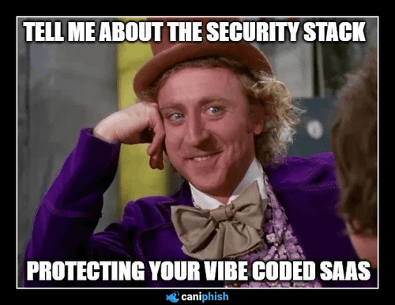
What Is the Attack Surface?
Every open port, service, account and app is a way in
Less running means less to attack

Slide 3
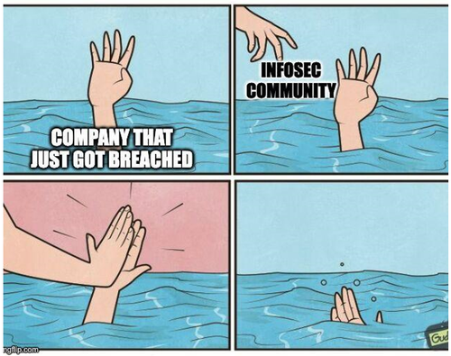
Out-of-the-Box Is Not Secure
Default passwords, default accounts, unneeded services
Vendors aim for "easy to set up", not "secure"
Example: IoT devices with default admin logins

Slide 4
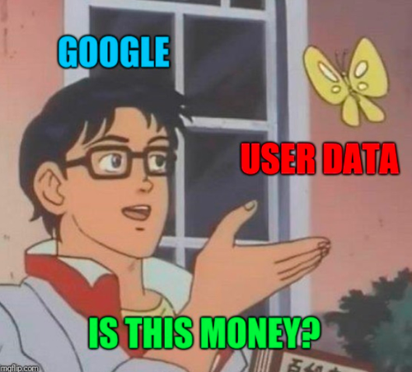
Disabling Unnecessary Services
How to find what's running (netstat, ss, services.msc)
If you don't know what it does, research it before turning it off
Remove software you don't use
The controversy over AI and if it's helpful or hurtful and if it gives another attack vector

Slide 5
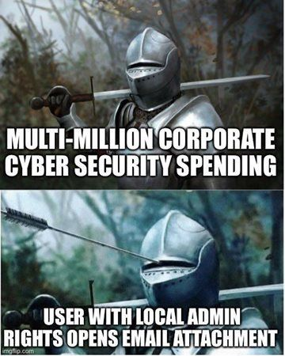
Accounts and Least Privilege
Remove or disable default and unused accounts
Don't use admin accounts for daily work
Give people only the access their job needs

Slide 6
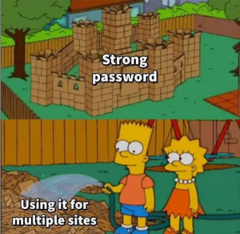
Password and Account Policies
Length beats complexity
Lockout policies and MFA
Balancing security with usability: too strict and people write passwords on sticky notes
Password policies that check boxes instead of help
  Example: Password must change every 90 days
  This means people tend to things like Fall2026! $pring2027

Slide 7
Industry Benchmarks
Why using a standard beats making it up yourself
A benchmark is an expert-agreed checklist of secure settings for a specific system
  Common sources: CIS Benchmarks, CIS Controls, DISA STIGs, and vendor baselines such as Microsoft's
  DISA STIGs for government work
Why use a standard instead of making it up yourself?
  Built and reviewed by experts across the industry
  Auditors, insurers and regulations (PCI DSS, HIPAA, CMMC) expect one
  Gives you a measurable score to track progress
Document exceptions when a setting breaks something you need

Slide 8
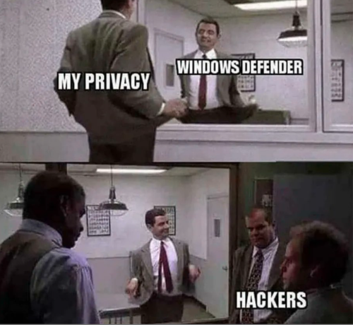
Hardening Tools
CIS-CAT, Lynis, Microsoft Security Compliance Toolkit
Activity: run Lynis on a Linux system and review the results

Slide 9
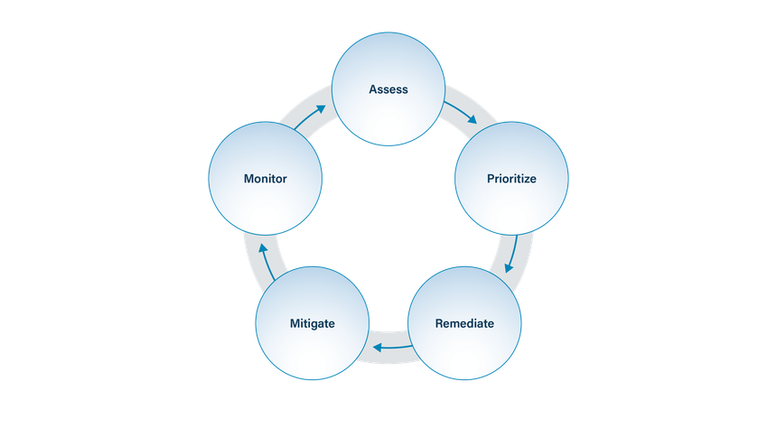
Patch Management
Most attacks use known, already patched vulnerabilities
Test, prioritize and schedule patches
Plan for systems that can't be patched
Consider issues with Legacy systems
https://essentialguide.docs.cisecurity.org/en/latest/bp/patching_vuln_management.html

Slide 10
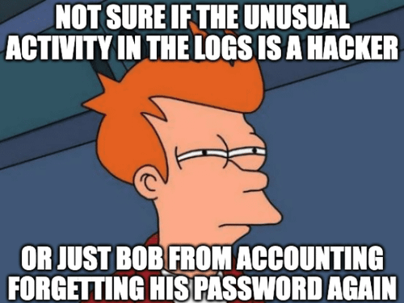
Configuration Baselines and Drift
Document what "secure" looks like for each system type
Systems drift over time as changes pile up
Use automation to check and enforce baselines
Nothing is real until it's written down, gossip is not documentation

Slide 11
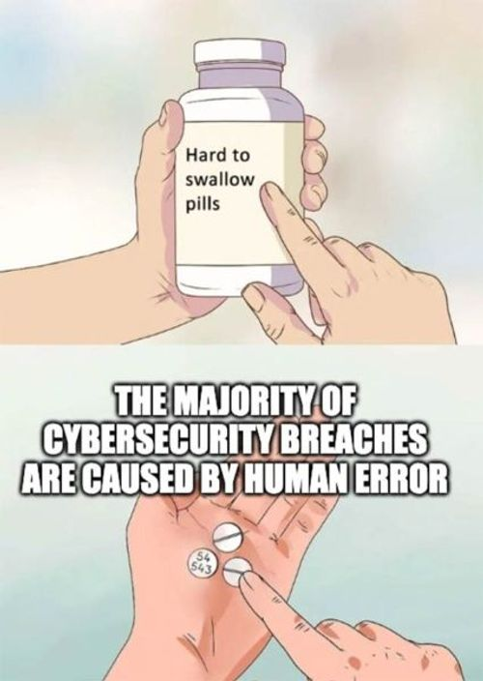
Hardening Your Personal Devices
Turn on automatic updates
Change router default passwords and update router firmware
Review app permissions on your phone
Turn on device encryption and a screen lock
Consider what apps you really need and get rid of the rest

Slide 12
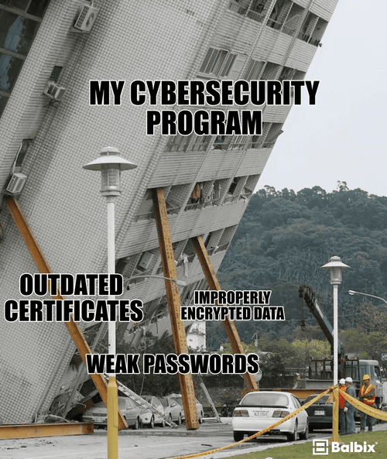
Hardening Is Ongoing
New vulnerabilities and new software keep appearing
Schedule regular reviews
Document every change

